Slide 1

Hospital Project
Himanshu Goswami

Slide 2
Table of Contents
About Columbia Asia Hospital
Problem Statement
Data Overview
Database Schema
Methodology
Data Cleaning Process
High Satisfaction Across All Ages
Key Patient Trends
General Practice Workload
Patient Demographic Breakdown
Wait Time Variation
Profit Margin Consistency
Patient Gender Distribution
Revenue Drivers
Discount Program Reach
Appointment Fee Structure
Dashboard
Recommendation

Slide 3
About Columbia Asia Hospital
Headquartered in Kuala Lumpur, Malaysia, Columbia Asia is an international chain of private hospitals founded in 1996. The group primarily serves the Southeast Asian market and currently runs 22 medical facilities in Malaysia, Indonesia, and Vietnam. Its strategy involves developing mid-sized hospitals in residential zones to cater to the middle-income demographic. Core medical specializations include general surgery, orthopedics, trauma care, and internal medicine, alongside comprehensive support services such as intensive care, physiotherapy, and neonatal units.

Slide 4
Problem Statement
This project will analyze revenue streams across the hospital, pinpoint opportunities for departmental workforce expansion, and develop recommendations for patient discount programs aimed at boosting both efficiency and patient contentment.

Slide 5
Data Overview
Patient Demographics
Patient ID: A unique alphanumeric identifier assigned to each patient (e.g., 124-62-3289).
Patient Gender: The gender of the patient, denoted by 'M' for Male and 'F' for Female.
Patient Age: The patient's age in complete years.
Patient Race: The patient's self-identified racial or ethnic background (e.g., 'White', 'African American', 'Asian', 'Native American/Alaska Native', 'Two or More Races').
Patient First Initial: The first letter of the patient's first name.
Patient Last Name: The surname of the patient.

Slide 6
Visit & Clinical Information
Date: The date and time of the patient's appointment or admission, presented in DD-MM-YYYY HH:MM format.
Patient Sat Score: A single-digit numerical rating related to patient satisfaction. (Note: The scale of this score, e.g., 1-5 or 1-10, is not explicitly defined).
Patient Admin Flag: A boolean field (TRUE or FALSE) likely indicating an administrative status, such as whether the patient was admitted.
Patient Wait Time: The time, presumed to be in minutes, that the patient waited before being attended to.
Department Referral: The medical department to which the patient was referred (e.g., 'General Practice', 'Orthopaedics', 'Gastroenterology'). A value of 'None' indicates no referral.
Doctor Name: The name of the physician or provider who handled the patient's case.
Financial Data
Appointment Fees: The fee charged for the doctor's consultation.
Total Bill: The complete financial charge for the patient's visit, including all services, fees, and procedures.

Slide 7
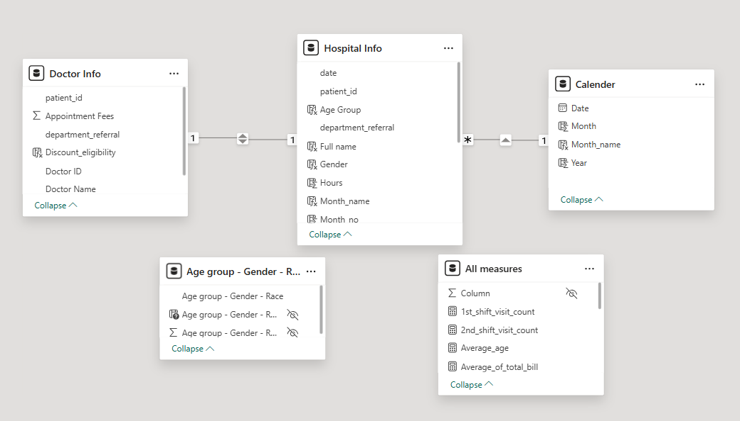
Database Schema

Slide 8
Methodology
Data Preparation: Executed data ingestion, cleaning, and transformation using Power Query to ensure data accuracy and model-readiness.
Data Modeling (DAX): Authored advanced DAX measures to create key performance indicators, using iterators (SUMX), time intelligence functions, and calculated columns for complex business logic.
Visualization: Designed a variety of visuals (bar charts, column charts, cards, gauges, pie charts) to clearly communicate analytical insights.
Dashboarding: Built a fully interactive dashboard by configuring slicers, drill-through filters, and visual interactions to provide a dynamic and comprehensive reporting experience.

Slide 9
Data Cleaning Process
Addressed Null Values: Filled missing Satisfaction Score entries with the mean to ensure analytical accuracy.
Created Time Dimension: Built a Calendar Table from the date column and established a relationship model for time-based analysis.
Identified Data Gaps: Checked for null values across the entire dataset to manage incomplete records.
Ensured Data Consistency: Verified and corrected data types in all columns to prevent errors.
Executed Cleaning: Performed all transformations in Power Query, then used 'Close & Apply' to load the clean data.

Slide 10
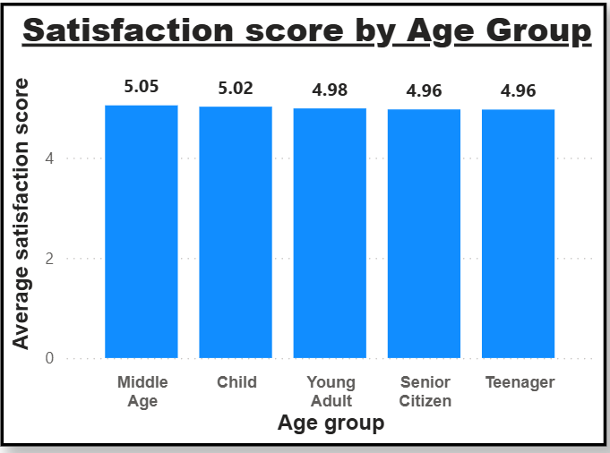
High Satisfaction Across All Ages
A key finding is the remarkable consistency in satisfaction scores across all age groups.
All demographics report a high average score, hovering just around 5.0.
The total variation is minimal (only 0.09), ranging from 5.05 (Middle Age) to 4.96 (Senior Citizen & Teenager).
This suggests a uniformly positive patient experience, regardless of age.

Slide 11
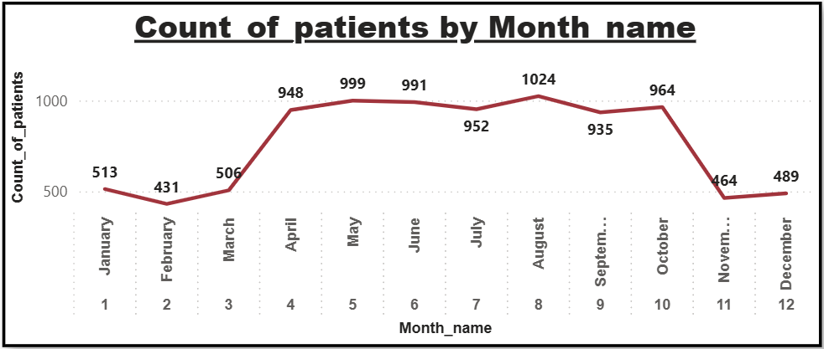
Key Patient Trends
Peak & Trough: Patient visits peaked in August (1,024) and reached their lowest point in February (431).
High Season: A sustained period of high patient volume occurred from April through October.
Low Season: The start (Jan-Mar) and end (Nov-Dec) of the year both registered significantly lower patient numbers.
Key Change: A sharp decline in visits is visible after October.

Slide 12
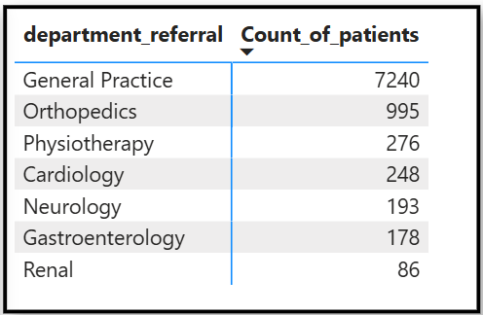
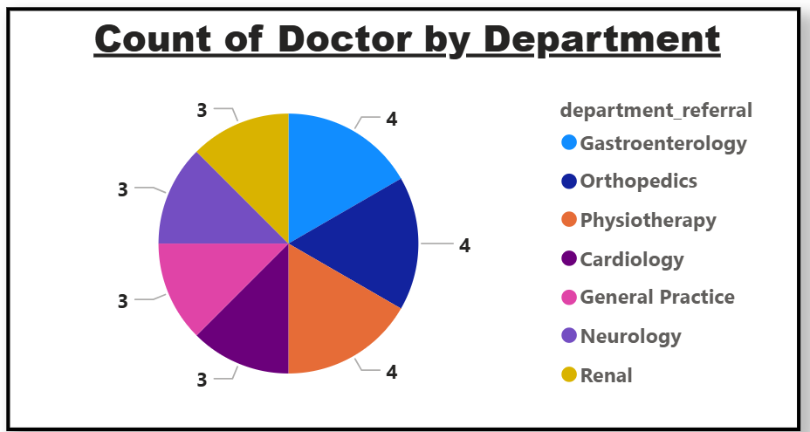
General Practice Workload
Overwhelming Patient Volume: The General Practice department handles the vast majority of patient visits, totaling 7,240.
Significant Outlier: This volume is more than 7x higher than the second-busiest department, Orthopedics (995 visits).
Staffing Imbalance: Despite managing the highest patient load, General Practice is staffed by only 3 doctors, indicating a severe potential workload imbalance.

Slide 13
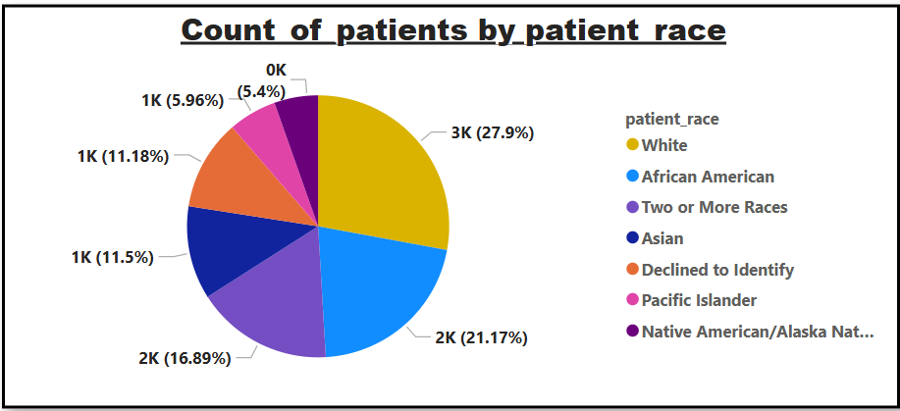
Patient Demographic Breakdown
"White" patients account for 27.9% of the total patient base.
The majority of patients (approx. 72%) are from other racial and ethnic groups.
Top Groups:
White: 27.9%
African American: 21.17%
Two or More Races: 16.89%
Smallest Group: "Native American/Alaska Native" at 5.4%.

Slide 14
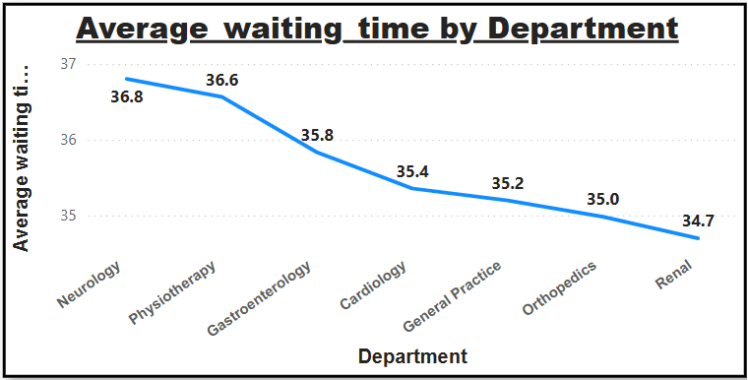
Wait Time Variation
The Neurology department recorded the longest average wait time at 36.8 minutes.
Conversely, the Renal department had the shortest average wait at 34.7 minutes.
This demonstrates high stability, as all departments operate within a very narrow 2.1-minute range.

Slide 15
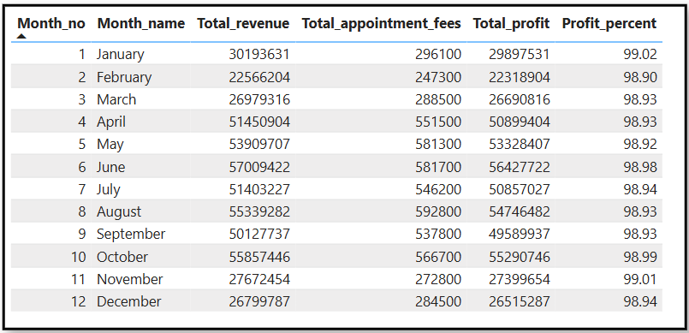
Profit Margin Consistency
A key financial finding is the hospital's high and stable profit margin.
The data shows very little monthly variation, with profit percentages consistently hovering just under 99%.
This indicates that costs (as represented in the data) are extremely low relative to total revenue, confirming high profitability.

Slide 16
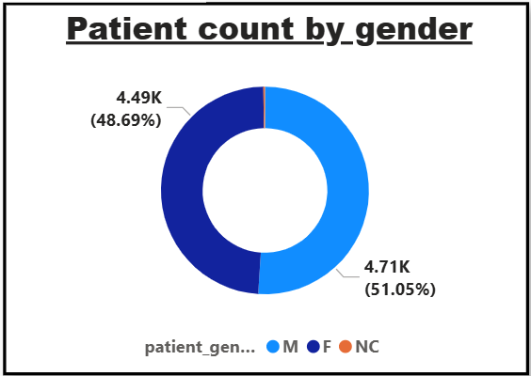
Patient Gender Distribution
The patient population is almost evenly split between genders.
Males represent a slight majority at 51.05% (4.71K patients).
Females make up the remaining 48.69% (4.49K patients).

Slide 17
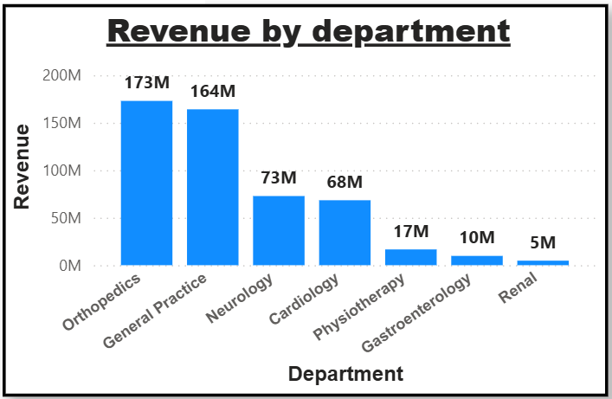
Revenue Drivers
Top Earners: Orthopedics (173M) and General Practice (164M) are the clear leaders, generating the vast majority of the hospital's revenue.
Second Tier: Neurology (73M) and Cardiology (68M) also represent significant sources of income.
Significant Drop-off: There is a sharp decline in revenue after the top four departments.
Lowest Earner: The Renal department contributes the least, with 5M in revenue.

Slide 18
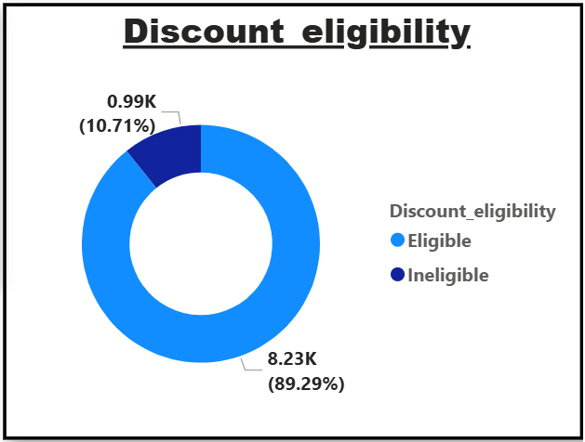
Discount Program Reach
Nearly 90% of all patients (8.23K) are eligible for a discount.
A small fraction, 10.71%, do not qualify.
This wide eligibility indicates the program's broad reach across the patient population.

Slide 19
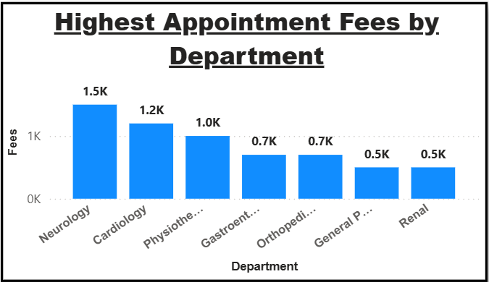
Appointment Fee Structure
Appointment fees vary significantly by specialty.
Neurology (1.5K) and Cardiology (1.2K) charge the highest fees.
The lowest fees are in General Practice (0.5K) and Renal (0.5K).
The fee for Neurology is 3x higher than the fee for General Practice.

Slide 20
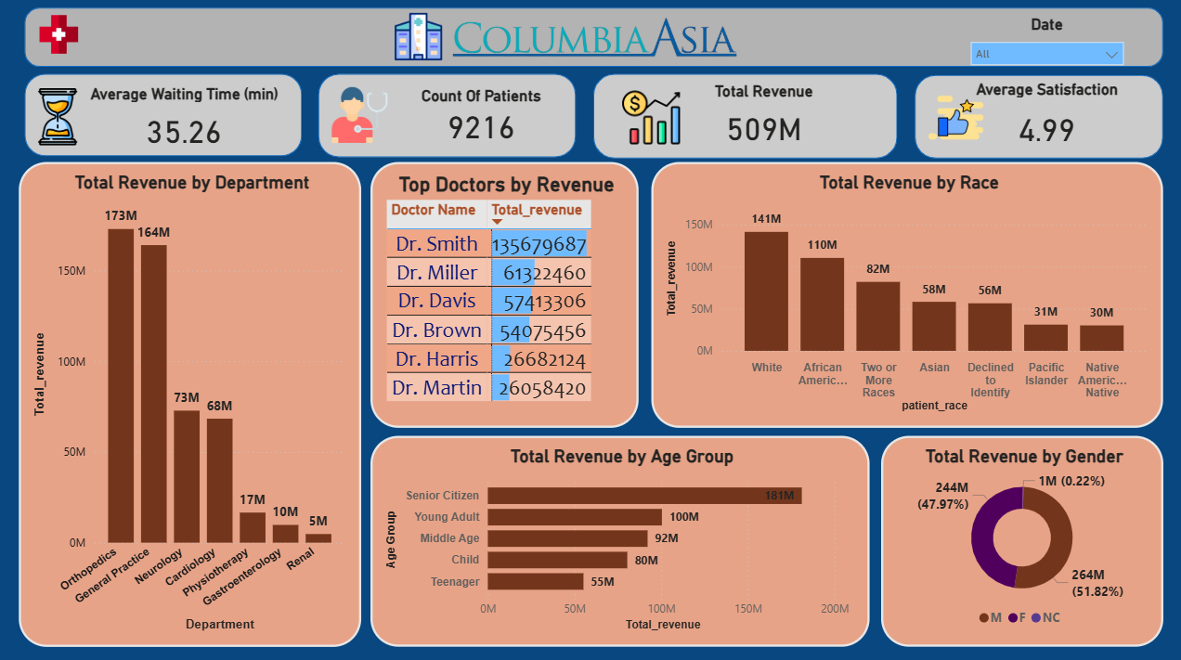
Main Dashboard

Slide 21
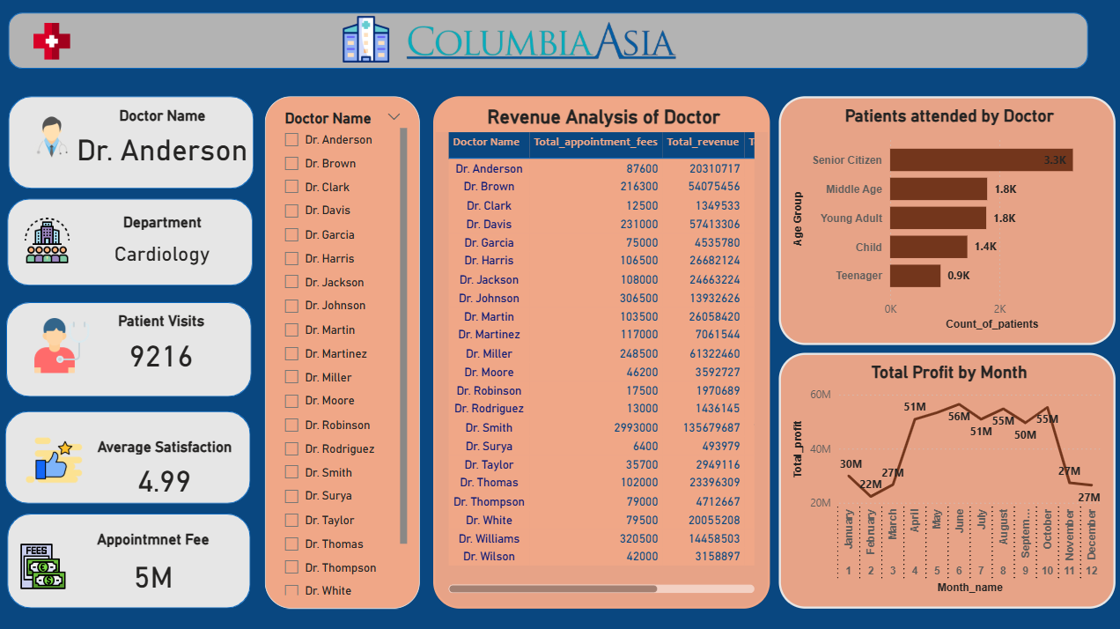
Doctor Dashboard

Slide 22
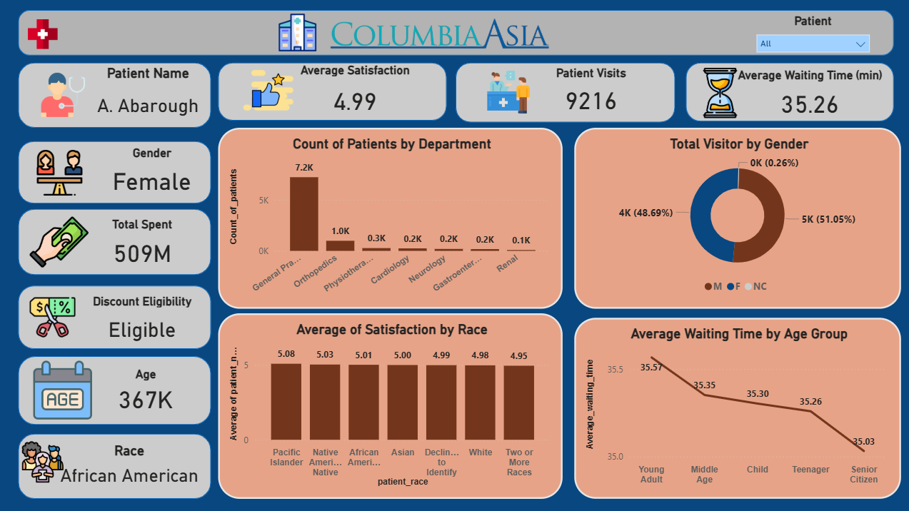
Patient Dashboard

Slide 23
Recommendation
Address General Practice Workload: Allocate additional resources to the high-traffic General Practice department. Hiring at least two new doctors is recommended to manage the high patient load effectively.
Adopt Seasonal Resource Planning: Adjust staffing to match seasonal patient volume. Increase resources during the peak period (April-October) and optimize schedules during lower-volume months (Jan-Mar, Nov-Dec).
Enhance Data-Driven Decisions: Utilize demographic insights and KPIs (revenue, satisfaction, wait times) to tailor services, optimize departmental performance, and inform strategic planning.
Implement Targeted Discount Programs: Encourage loyalty and high-value spending by offering discounts to key revenue-driving groups (e.g., teenagers) or for total bills exceeding a specific threshold (e.g., ₹10,000).
Maximize Revenue Opportunities: Analyze the contributing factors for underperforming departments, such as Renal, and implement targeted improvement plans to boost their financial contribution.

Slide 24

THANK YOU

